Slide 1

The impact of student life on Student Performance
By Aaron Drexler

Slide 2
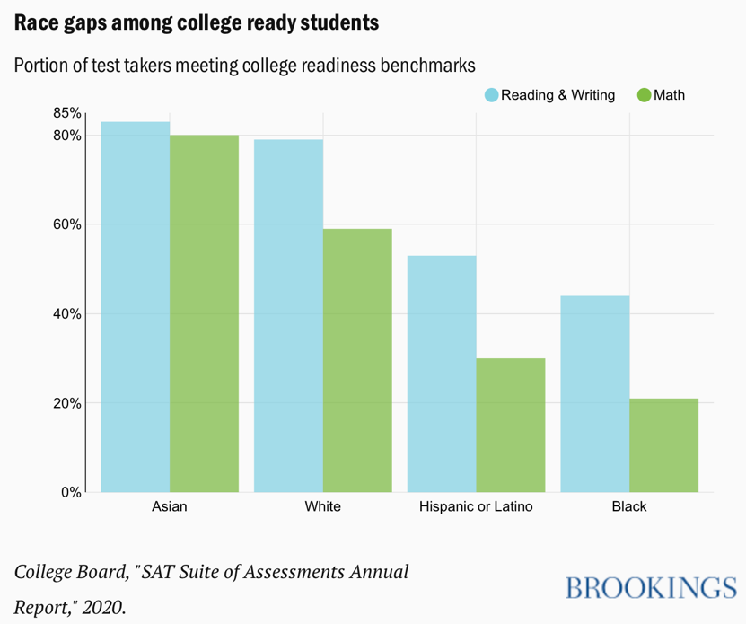
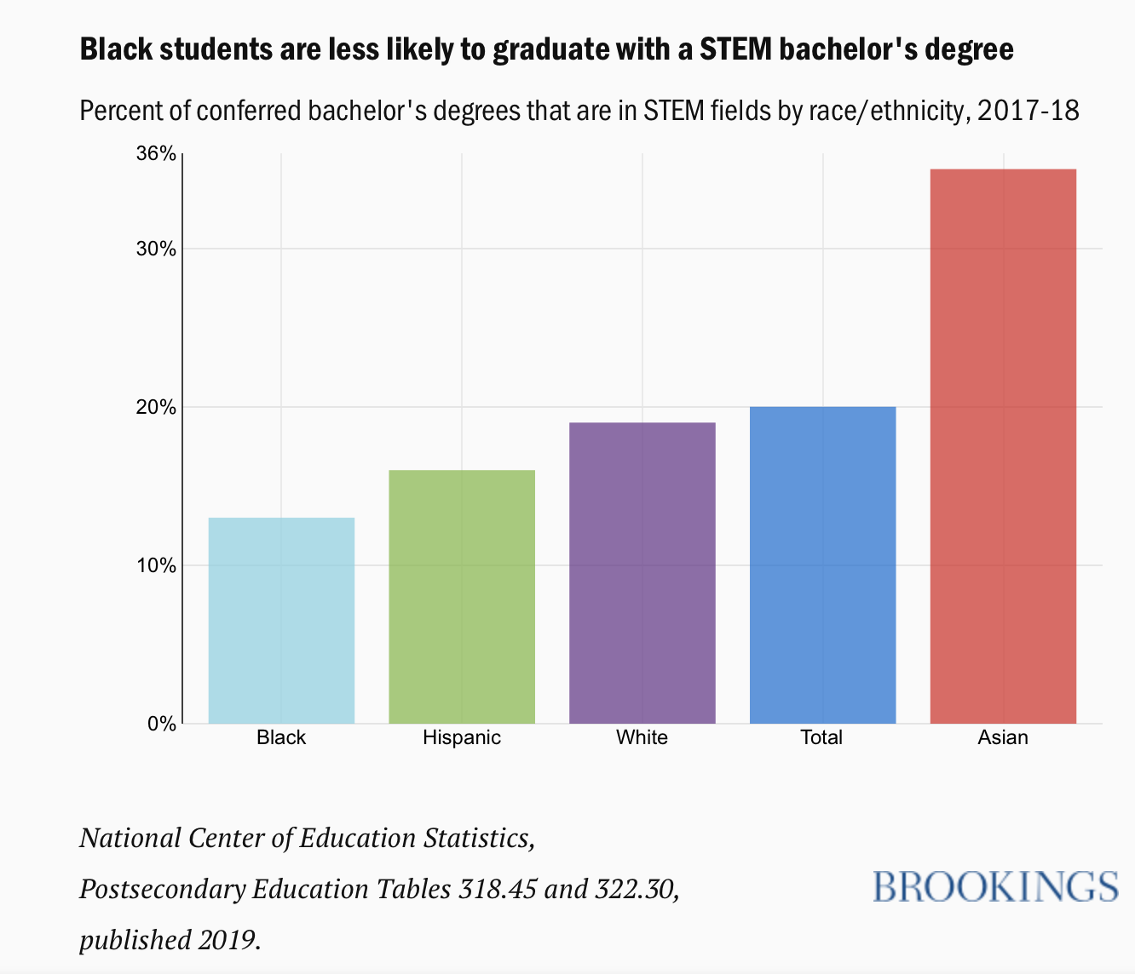
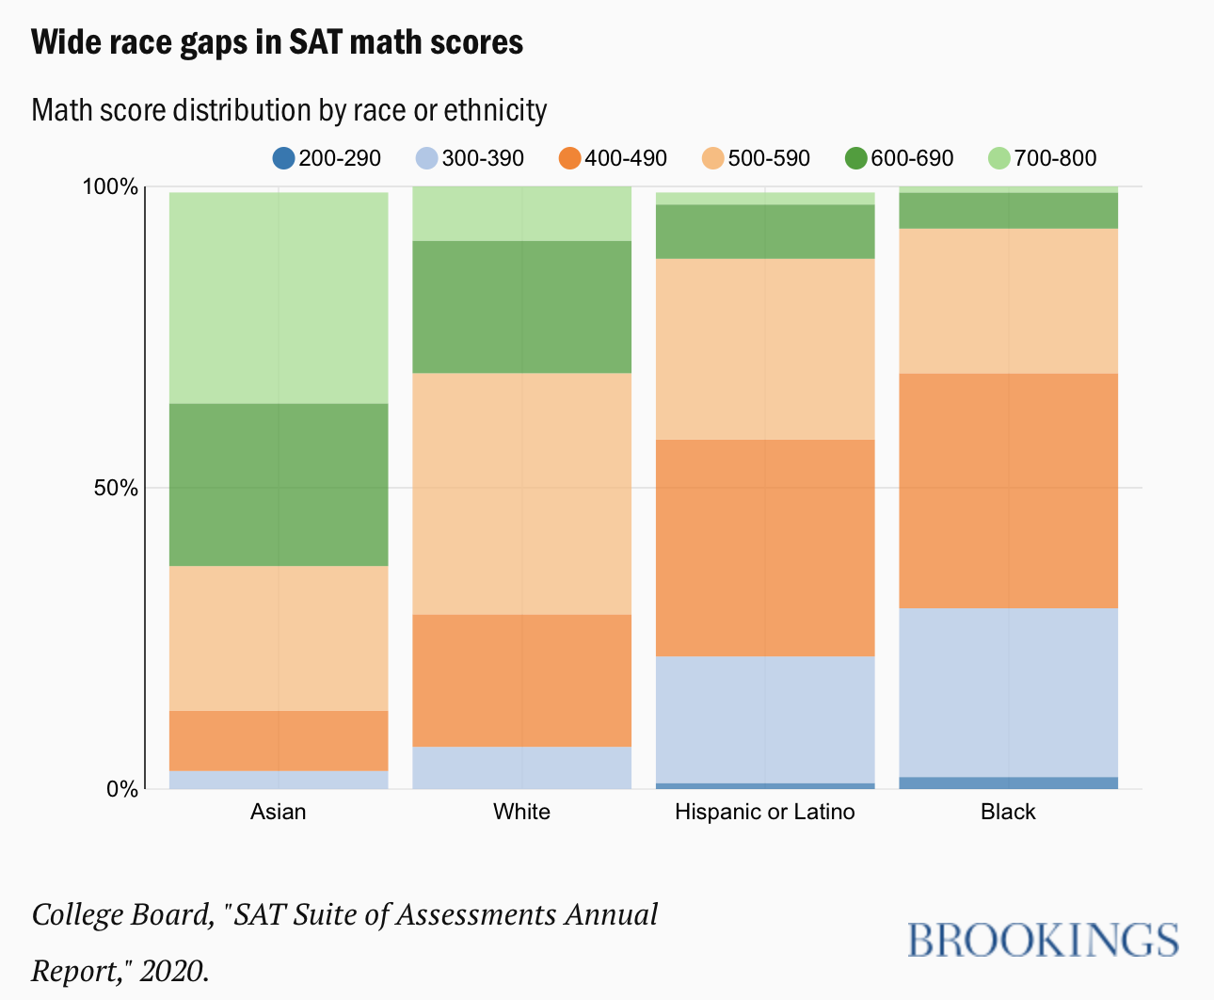
Why we care
Equity in education
Education Gap

Slide 3

Why I care
I am a Math Teacher
Focus for teaching math is equity, in ensuring every student is receiving the best opportunities to succeed
It is personal for me as I teacher the students in my school who are on the lower end of that educational gap
Many are minorities

Slide 4
Data
student’s school
student’s sex
student’s age
student’s family size
parental cohabitation status
mother’s education
father’s education
mother’s job
father’s job
guardian
home to school travel time
weekly study time
number of past class failures
extra educational support
family educational support
extra-curricular activities
wants to take higher education
home internet access
in a romantic relationship
quality of family relationships
free time after school
going out with friends
health status
absences
math scores
https://www.kaggle.com/janiobachmann/math-students/version/1
Large amount of secondary information about students’ personal lives, habits, math performance, and backgrounds
Variables include:

Slide 5
Plan
Focus on variables that student’s have control over:
math scores (G3 is the final grade)
weekly study time
extra-curricular activities
in a romantic relationship
free time after school
going out with friends
Absences
Going to compare and look correlation between math scores and the secondary characteristics and measurables of students
Metric used is called Pearson Correlation
Visualization type: Correlation heat map

Slide 6

R-Code

Slide 7
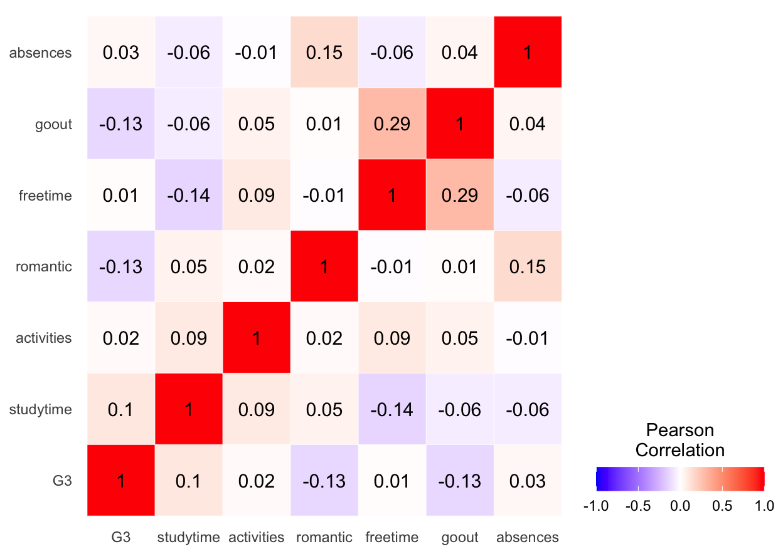
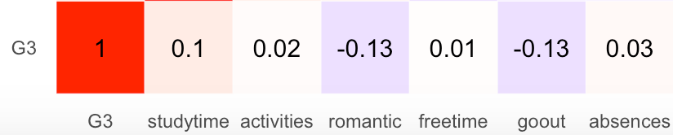
Pearson Correlation Heat Map
Focus on bottom row/ first column
Correlations between Math scores and secondary variables

Slide 8
Issues with Data
Small amount of data entries (only 150)
Population bias (based on 1 teacher’s data)
Low correlation scores
Compare G3 scores to the max correlation in data (0.15) to compare relative correlation strength
Due to small population and data availability

Slide 9

Data Correlation Scores in comparison to Math grades
Strong Positive Correlation
Studying time
0.10/0.15
Strong Negative Correlation
Being in a relationship
Going out after School
0.13/0.15
Weak correlations
Free Time after school: correlation=0.01
Activities after School: correlation =0.02
Number of Absences: correlation= 0.03

Slide 10

Conclusions/Take-aways
Strong negative variables 33% more impactful than positive variables
High School romantic relationships have a strong impact on grades
Surprise in data
Absences from class had weak positive impact on grade
Expected to have negative impact
While Free time and Going out have a strong correlation between themselves, they have a big difference in correlations with grades

